Slide 1


ELK: Ruminating On Logs
Elasticsearch, Logstash & Kibana
iStock.com/SBTheGreenMan
Notes:
1. think deeply about something. 2. (of a ruminant) chew the cud

Slide 2


Mathew Beane
@aepod
Director of Systems Engineering - Robofirm
Magento Master and Certified Developer Zend Z-Team Volunteer – Magento Division Family member – 3 Kids and a Wife
Linux since 1994 (Slackware 1.0)
PHP since 1999
Life long programmer and sysamin
Notes:
Life long computer geek
First computer build 1980’s
First linux install 1994 (slackware linux 1.0 days)
Learned solaris for video game industry work
Moved to Server Room work
PHP in 2000
Ecommerce in 2006
Magento 2008

Slide 3

Todays Plan
Stack Overview
Installation
Production Considerations
Logstash
Log Shipping
Visualizations (Kibana)

Slide 4
ELK Introduction / Overview

Slide 5
ELK Overview
Stack Components by Type
Shippers
Brokers
Storage / Processing
Visualization
Elasticsearch: NoSQL DB Storage
Logstash: Data Collection & Digestion
Kibana: Visualization standard.
https://www.digitalocean.com/community/tutorials/how-to-install-elasticsearch-logstash-and-kibana-elk-stack-on-centos-7
Notes:
Logstash and Log shippers!!!!

Slide 6
ELK Data Flow
Shippers | Brokers | Storage / Processing | Visualization
Beats Syslogd Many others… | RabbitMQ Redis | Logstash into Elasticsearch | Kibana Graphana And others…
Notes:
Logstash and Log shippers!!!!

Slide 7
ELK Versions
Elasticsearch: 2.4.1 Logstash: 2.4.0 Kibana: 4.6.1
Right now everything is a mishmash of version numbers.
Soon everything will be version 5, version locked to one another. RC1 out now.
Learning all the logos is a little bit like taking a course in Hieroglyphics.
Elastic has hinted that the naming will become simplified in the future.
From the Elastic Website
Notes:
V5.0 is RC1 now, and in good shape.
Oh look, yet another round of new Logos.

Slide 8
Elastic SaaS & Elastic Cloud
Notes:
Elastic Cloud starts at $45 / month, has most the x-pack features.
Pricing on x-pack pricing for gold or platinum upon request.
Enterprise features, nice looking gui and a 14 day free no strings attached trial.
Monitoring is the only free component.

Slide 9
ELK Components Stack
Elasticsearch: Cluster ready, for nice horizontal and vertical scaling.
Logstash: Chain together multiple instances for super powered log pipelines.
Kibana: Stacking is typically not needed. Although you will want to plug in other visualizers.
Other Stack Components
Brokers: Redis, RabbitMQ
Logshippers: Beats, rsyslogd and others.
Visualization: Utilize Graphana or Kibana plugins, the sky is the limit.
X-Pack: Security, alerting, additional graphing and reporting tools.
Elk are not known for their stack-ability.
Notes:
Logstash is very flexible, you can do HA and other configurations easily.

Slide 10

Open Source
Search/Index Server
Distributed Multitenant Full-Text Search
Built on top of Apache Lucene
Restful API
Schema Free
Highly Available / Clusters Easily
json Query DSL exposes Lucene’s query syntax
https://github.com/elastic/elasticsearch
Notes:
DSL = Domain Specific Language

Slide 11

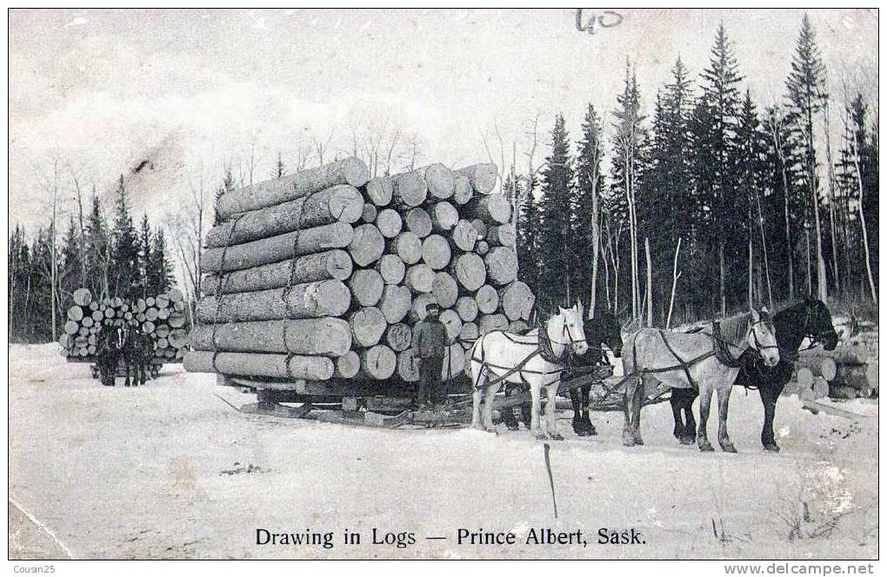
Logstash
Data Collection Engine
Unifies Disparate Data
Ingestion Workhorse for ELK
Pluggable Pipeline:
Inputs/Filters/Outputs
Mix and Match as needed
100’s of Extensions and Integrations
Consume web services
Use Webhooks (Github,Jira,Slack)
Capture HTTP Endpoints to monitor web applications.
https://github.com/elastic/logstash

Slide 12



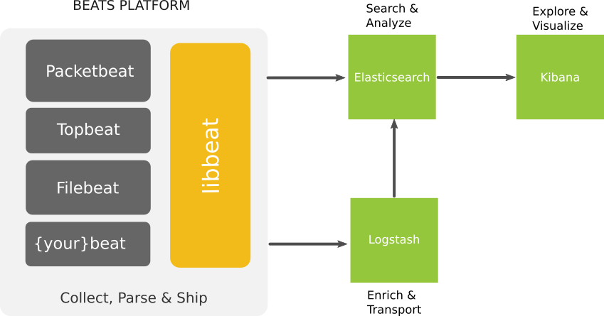
Beats
Lightweight - Smaller CPU / memory footprint
Suitable for system metrics and logs.
Configuration is easy, one simple YAML
Hook it into Elasticsearch Directly
Use Logstash to enrich and transport
libbeat and plugins are written entirely in Golang
Introducing Beats: P-Diddy and Dr. Dre showing Kibana Dashboard
https://github.com/elastic/beats
Notes:
Go is an open source programming language that makes it easy to build simple, reliable, and efficient software.

Slide 13
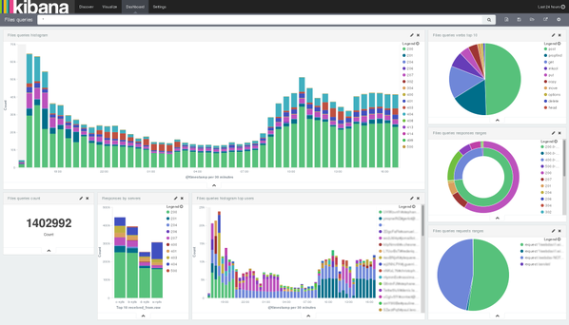

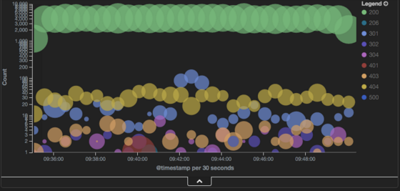
Flexible visualization and exploration tool
Dashboards and widgets make sharing visualizations possible
Seamless integration with Elasticsearch
Learn Elasticsearch Rest API using the visualizer
Typical Kabana Dashboard: Showing Nginx Proxy information
Nginx Response Visualization from: http://logz.io/learn/complete-guide-elk-stack/
https://github.com/elastic/kibana

Slide 14


ELK Challenges
Setup and architecture complexity
Mapping and indexing
Conflicts with naming
Log types and integration
Capacity issues
Disk usage over time
Latency on log parsing
Issues with overburdened log servers
Logging cluster health
Cost of infrastructure and upkeep
Notes:
Mention truck factor

Slide 15

Alerts
Unique Alerts system proprietary built on top of open source ELK transform the ELK into a proactive system
ELK as a Service
5 Minutes setup – Just plug in your shippers
14 day no strings attached trial
Feature Rich Enterprise-Grade ELK
Alerts
S3 Archiving
Multi-User Support
Reporting
Cognitive Insights
Advanced Security
360 degrees security with role based access and multi-layer security
Highly Available
Data and entire data ingestion pipeline can sustain downtime in full datacenter without losing data or service
Up and running in minutes
Sign up in and get insights into your data in minutes
Infinitely scalable
Ship as much data as you want whenever you want
Production ready
Predefined and community designed dashboard, visualization and alerts are all bundled and ready to provide insights
Notes:
Cognitive Insights is an example of one of the many benefits to using Logz.io

Slide 16
ELK Introduction / Overview

Slide 17
ELK Example Installation
ELK Stack Server
Java 8 (Prerequisite)
Elasticsearch
Logstash
Kibana
Nginx Fastcgi Proxy
Install Server Stack (30 Minutes)
Install Java
Install Elasticsearch
Install Logstash
Create SSL Certificate
Configure Logstash
Install Kabana (30 Minutes)
Install /Configure Elastic Kabana
Install / Configure Nginx Proxy
Client Servers
Elastic Beats
Filebeat
Time per Server (20 Minutes)
Add SSL Certificate
Install Elastic Beats
Configure Filebeats
Start Beats service
Kibana Config & Explore
Kibana Configuration (5 Minutes)
Configure Kabana Index
Add Filebeat Index Template
Start using Kabana
Kibana Explore
Using collected metrics create a search
Use the search to create visualizations
Use visualizations to create dashboards * Time to complete results may vary
https://www.digitalocean.com/community/tutorials/how-to-install-elasticsearch-logstash-and-kibana-elk-stack-on-centos-7
https://www.digitalocean.com/community/tutorials/how-to-install-elasticsearch-logstash-and-kibana-elk-stack-on-ubuntu-14-04

Slide 18
ELK Server Install – Elastic Components
Install Java Typically install Oracle Java 8 via your preferred package manager. OpenJDK should work as well.
Install Elasticsearch Elasticsearch can be installed via the package manager, add the elastic GPG Key and the repository, then install it. Very little configuration is needed to make it work enough for ELK Stack. *See step 5 below
Install Logstash Installed from the same repository as Elasticsearch.
Create SSL Certificate Filebeats Requires an SSL certificate and keypair. This will be used to verify the identity of the ELK Server.
Configure Logstash Add beats input, syslog filter, and elasticsearch output.

Slide 19
ELK Server - Logstash Configuration
Input
Output
Filter
Notes:
From beats, through the syslog filter into the elasticsearch output.
Input -> Filter -> output (come back to this in more detail later)
More about filters later, but these match to types that you can send from beats.

Slide 20
ELK Server Install – Kibana Install
Install Kibana The elastic GPG should have been added during the initial install. Install from the package manager.
Configure and Start Kibana In the kibana.yml change server.host to be localhost only, because nginx will be connect to it via localhost.
Install Nginx Typical Nginx install, you may want apache2-utils which provides htpasswd.
Configure and Start Nginx Basic Nginx proxy configuration, Kibana handles the requests.

Slide 21
ELK Install – Client Stack
Copy SSL Certificate in from Server You will want to place the crt file from the certificate you generated in in /etc/pki/tls/certs/
Install Elastic Beats As before, you will need to add the GPG Key and Repository before installing any of the beats. Install the Filebeat package and move onto the configuration.
Configure and Start Filebeat for logs Take a look at the /etc/filebeat/filebeat.yml and modify the sections according to the Digital Ocean blog article.
Modify Prospectors to include /var/log/secure and /var/log/messages
Modify the document type for these to be syslog *Matches Logstash type
Modify the logstash host to reflect your logstash server
Add your certificate path to the tls section
Notes:
TLS = Transport Layer Security

Slide 22
Filebeats Configuration
server
client
Logstash input/filter/output
https://gist.github.com/thisismitch/3429023e8438cc25b86c

Slide 23
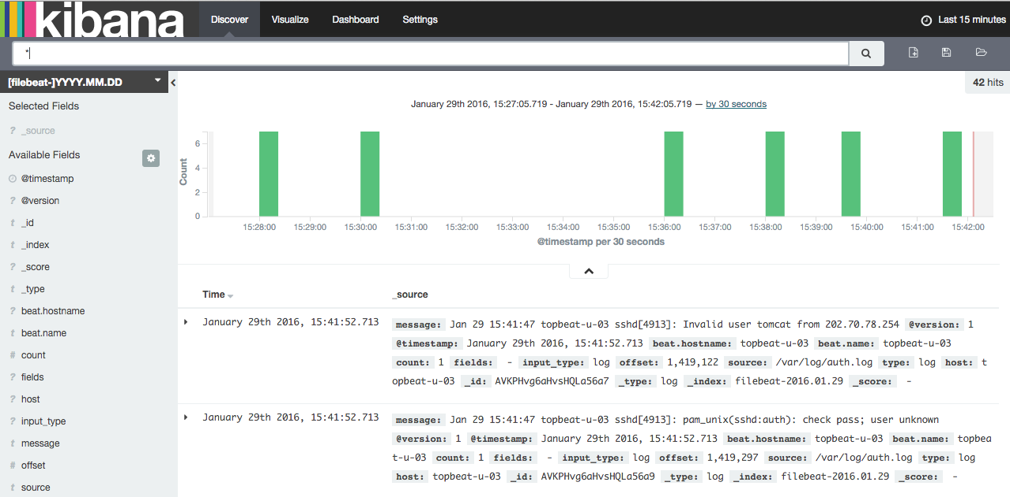
ELK Install – Kibana Config
Initialize Kabana Index
Install filebeat-index-template.json into Kabana
Start Using Kabana
Using collected metrics create a search
Use the search to create visualizations
Use visualizations to create dashboards

Slide 24
ELK In Production
Notes:
We will go over a few of the pain points, and interesting parts of trying to build ELK out to production scale.

Slide 25

Elasticsearch at Production Scale
OS Level Optimization: Required to run properly as it is not performant out of the box. Index Management: Index deletion is an expensive operation , leading to more complex log analytics solutions. Shard Allocation: Optimizing inserts and query times requires attention. Cluster Topology and Health Elastic search clusters require 3 Master nodes, Data nodes and Client nodes. It clusters nicely but it requires some finesse.
Notes:
~4-6 weeks of work

Slide 26

Elasticsearch at Production Scale
Capacity Provisioning: Log bursts, Elasticsearch catches fire. This can also cause cost stampeding. Dealing with Mapping Conflicts: Mapping conflicts, and other sync issues need to be detected and addressed. Disaster Recovery: Archiving data, allowing for a recovery in case of a disaster or critical failure. Curation: Even more complex index management, creating, optimizing and sometimes just removing old indices.
Notes:
~4-6 weeks of work

Slide 27

Logstash at Production Scale
Data parsing: Extracting values from text messages and enhancing it. Scalability: Dealing with increase of load on the logstash servers. High Availability: Running logstash in a cluster is less trivial than Elasticsearch. Burst Protection: Buffering using Redis, RabbitMQ, Kafka or other broker is required in front of logstash. Configuration Management: Changing configurations without data loss can be a challenge.
More Reading: https://www.elastic.co/guide/en/logstash/current/deploying-and-scaling.html
Notes:
~4-6 weeks of work Given all this, this is why something like logz.io has worked out well for us.

Slide 28
Kibana at Production Scale
Security: Kibana has no protection by default. Elastic Shield offers very robust options. Role Based Access: Restricting users to roles is also supported via Elastic Shield if you have Elastic Support. High Availability: Kibana clustering for high availability or deployments is not difficult. Monitoring: Monitoring is offered free in the X-Pack, this allows for detailed statistics on the ELK stack. | Alerts: Take monitoring and create alerts when things go bad. This is part of the X-Pack. Dashboards: Building Dashboards and visualizations is tricky, will take a lot of time and will require special knowledge. ELK Stack Health Status This is not build into Kibana, there is a need for basic anomaly detection.
Notes:
~4-6 weeks of work

Slide 29
Logstash

Slide 30
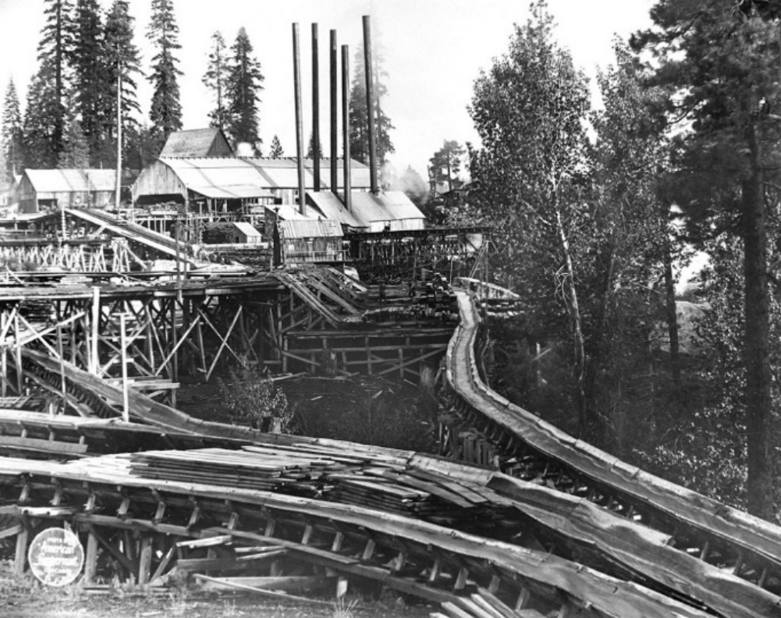
Logstash Pipeline
Event processing pipeline has three stages:
Input: These ingest data, many options exists for different types
Filter: Take raw data and makes sense of it, parsing it into a new format
Output: Sends data to a stream, file, database or other places.
Input and output support codecs that allow you to encode/decode data as it enters/exits the pipeline.

Slide 31
Logstash Processing Pipeline
Input | Filter | Output
Beats: The example uses beats to bring in syslog messages from filebeat on the clients in its native format. | Grok: Used to split up the messages into fields Date: Used to process the timestamp into a date field | Elasticsearch: Stored data, able picked up by Kabana using the default json codec
https://www.elastic.co/guide/en/logstash/current/pipeline.html

Slide 32
Logstash Processing Pipeline
Input
Output
Filter
https://www.elastic.co/guide/en/logstash/current/pipeline.html

Slide 33
Logstash Inputs
Beats: Events from Elastic Beats framework
Elasticsearch: Reads results from Elasticsearch
Exec: Captures the output of a shell command
File: Streams events from a file
Github: Read events from a github webhook
Heroku: Events from the logs of a Heroku app
http: Events over HTTP or HTTPS
irc: Read events from an IRC server
pipe: Stream events from a command pipe
Puppet_factor: Read puppet facts
RabbitMQ: Pull from a RabbitMQ Exchange
Redis: Read events from redis instance
Syslog: Read syslog messages
TCP: Read events from TCP socket
Twitter: Read Twitter Steaming API events
UDP: Read events over UDP
Varnishlog: Read varnish shared memory log
https://www.elastic.co/guide/en/logstash/current/input-plugins.html

Slide 34
Logstash Filters
Aggregate: Aggregate events from a single task
Anonymize: Replace values with consistent hash
Collate: Collate by time or count
CSV: Convert csv data into fields
cidr: Check IP against network blocks
Clone: Duplicate events
Date: Parse dates into timestamps
DNS: Standard reverse DNS lookups
Geoip: Adds Geographical information from IP
Grok: Parse data using regular Expressions
json: Parse JSON events
Metaevent: Add fields to an event
Multiline: Parse multiline events
Mutate: Performs mutations
Ruby: Parse ruby code
Split: Split up events into distinct events
urldecode: Decodes URL-encoded fields
xml: Parse xml into fields
https://www.elastic.co/guide/en/logstash/current/filter-plugins.html
Notes:
Common mutations: join, lowercase/uppercase, remove_tag, remove_field, replace, split, strip

Slide 35
Logstash Outputs
CSV: Write lines in a delimited file.
Cloudwatch: AWS monitoring integration.
Email: Email with the output of the event.
Elasticsearch: The most commonly used.
Exec: Run a command based on the event data.
File: Glob events into a file on the disk.
http: Send events to an http endpoint.
Jira: Create issues in jira based on events.
MongoDB: Write events into MongoDB
RabbitMQ: Send into a RabbitMQ exchange
S3: Store as files in an AWS s3 bucket.
Syslog: Sends event to a syslog server.
Stdout: Use to debug your logstash chains.
tcp/udp: Writes over socket, typically as json.
https://www.elastic.co/guide/en/logstash/current/output-plugins.html
Notes:
Typical output codec is jsonish
S3 bucket streaming in/out very handy!

Slide 36

Enriching Data with Logstash Filters
Grok: Uses regular expressions to parse strings into fields, this is very powerful and easy to use. Stack grok filters to be able to do some very advanced parsing. Handy Grok Debugger: http://grokdebug.herokuapp.com/
Drop: You can drop fields from an event, this can be very useful if you are trying to focus your filters.
Elasticsearch: Allows for previously logged data in logstash to be copied into the current event.
Translate: Powerful replacement tool based on dictionary lookups from a yaml or regex.
Notes:
You can chain together as many of these as you want.

Slide 37
Log Shipping

Slide 38
Log Shipping Overview
Log shippers pipeline logs into logstash or directly into Elasticsearch. There are many different options with overlapping functionality and coverage.
Logstash: Logstash can be thought of as a log shipper and it is commonly used.
Rsyslog: Standard logshipper, typically already installed on most linux boxes.
Beats: Elastic’s newest addition to log shipping, lightweight and easy to use.
Lumberjack: Elastic’s older log shipper, Beats has replaced this as the standard Elastic solution.
Apache Flume: Distributed log collector, less popular among the ELK community
Notes:
We are only going to look briefly at rsyslog and Beats. Does anyone use lumberjack or flume still?

Slide 39
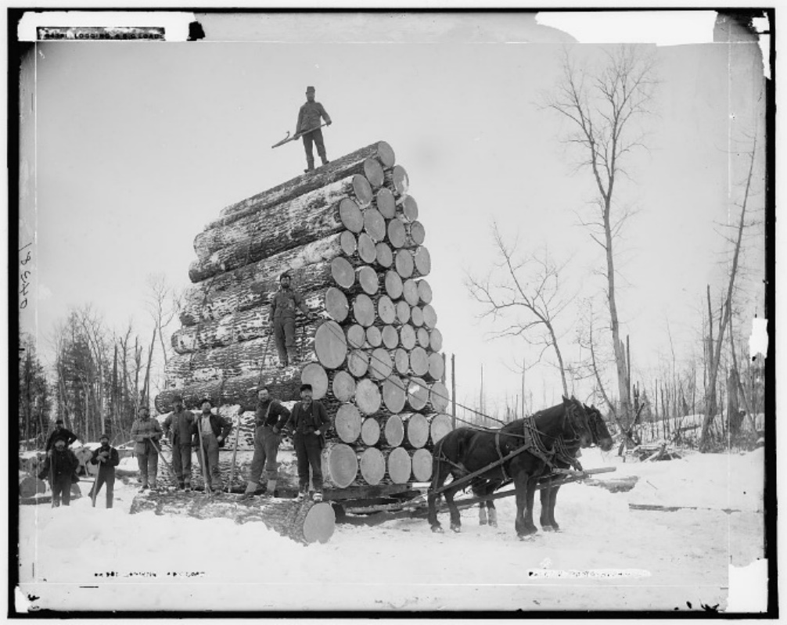
Logstash - Brokers
A must for production and larger environments.
Rsyslog & Logstash built-in queuing is not enough
Easy to setup, very high impact on performance
Redis is a good choice with standard plugins
RabbitMQ is also a great choice
These function as INPUT/OUTPUT logstash plugins
http://www.nightbluefruit.com/blog/2014/03/managing-logstash-with-the-redis-client/ http://dopey.io/logstash-rabbitmq-tuning.html

Slide 40
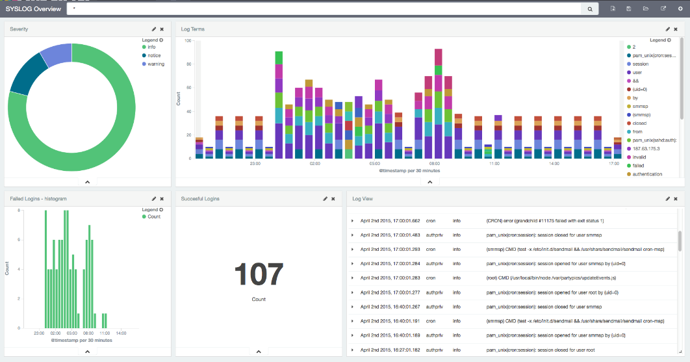
Rsyslog
Logstash Input Plugin for Syslog works well.
Customize Interface, Ports, Labels
Easy to setup
Filters can be applied in logstash or in rsyslog
Logstash Input Filter
Kibana view of syslog events.
https://www.elastic.co/guide/en/logstash/current/plugins-inputs-syslog.html
Notes:
Rsyslog has its own filtering and abilities around that.

Slide 41


Beats – A Closer Look
Filebeat: Used to collect log files.
Packetbeat: Collect Network Traffic
Topbeat: Collect System Information
Community Beats: Repo of Community Beats: https://github.com/elastic/beats/blob/master/libbeat/docs/communitybeats.asciidoc Beats Developers Guide: https://www.elastic.co/guide/en/beats/libbeat/current/new-beat.html
Apachebeat
Dockerbeat
Execbeat
Factbeat
Nginxbeat
Phpfpmbeat
Pingbeat
Redisbeat
Notes:
Beats is written in Golang, most are very well documented.

Slide 42
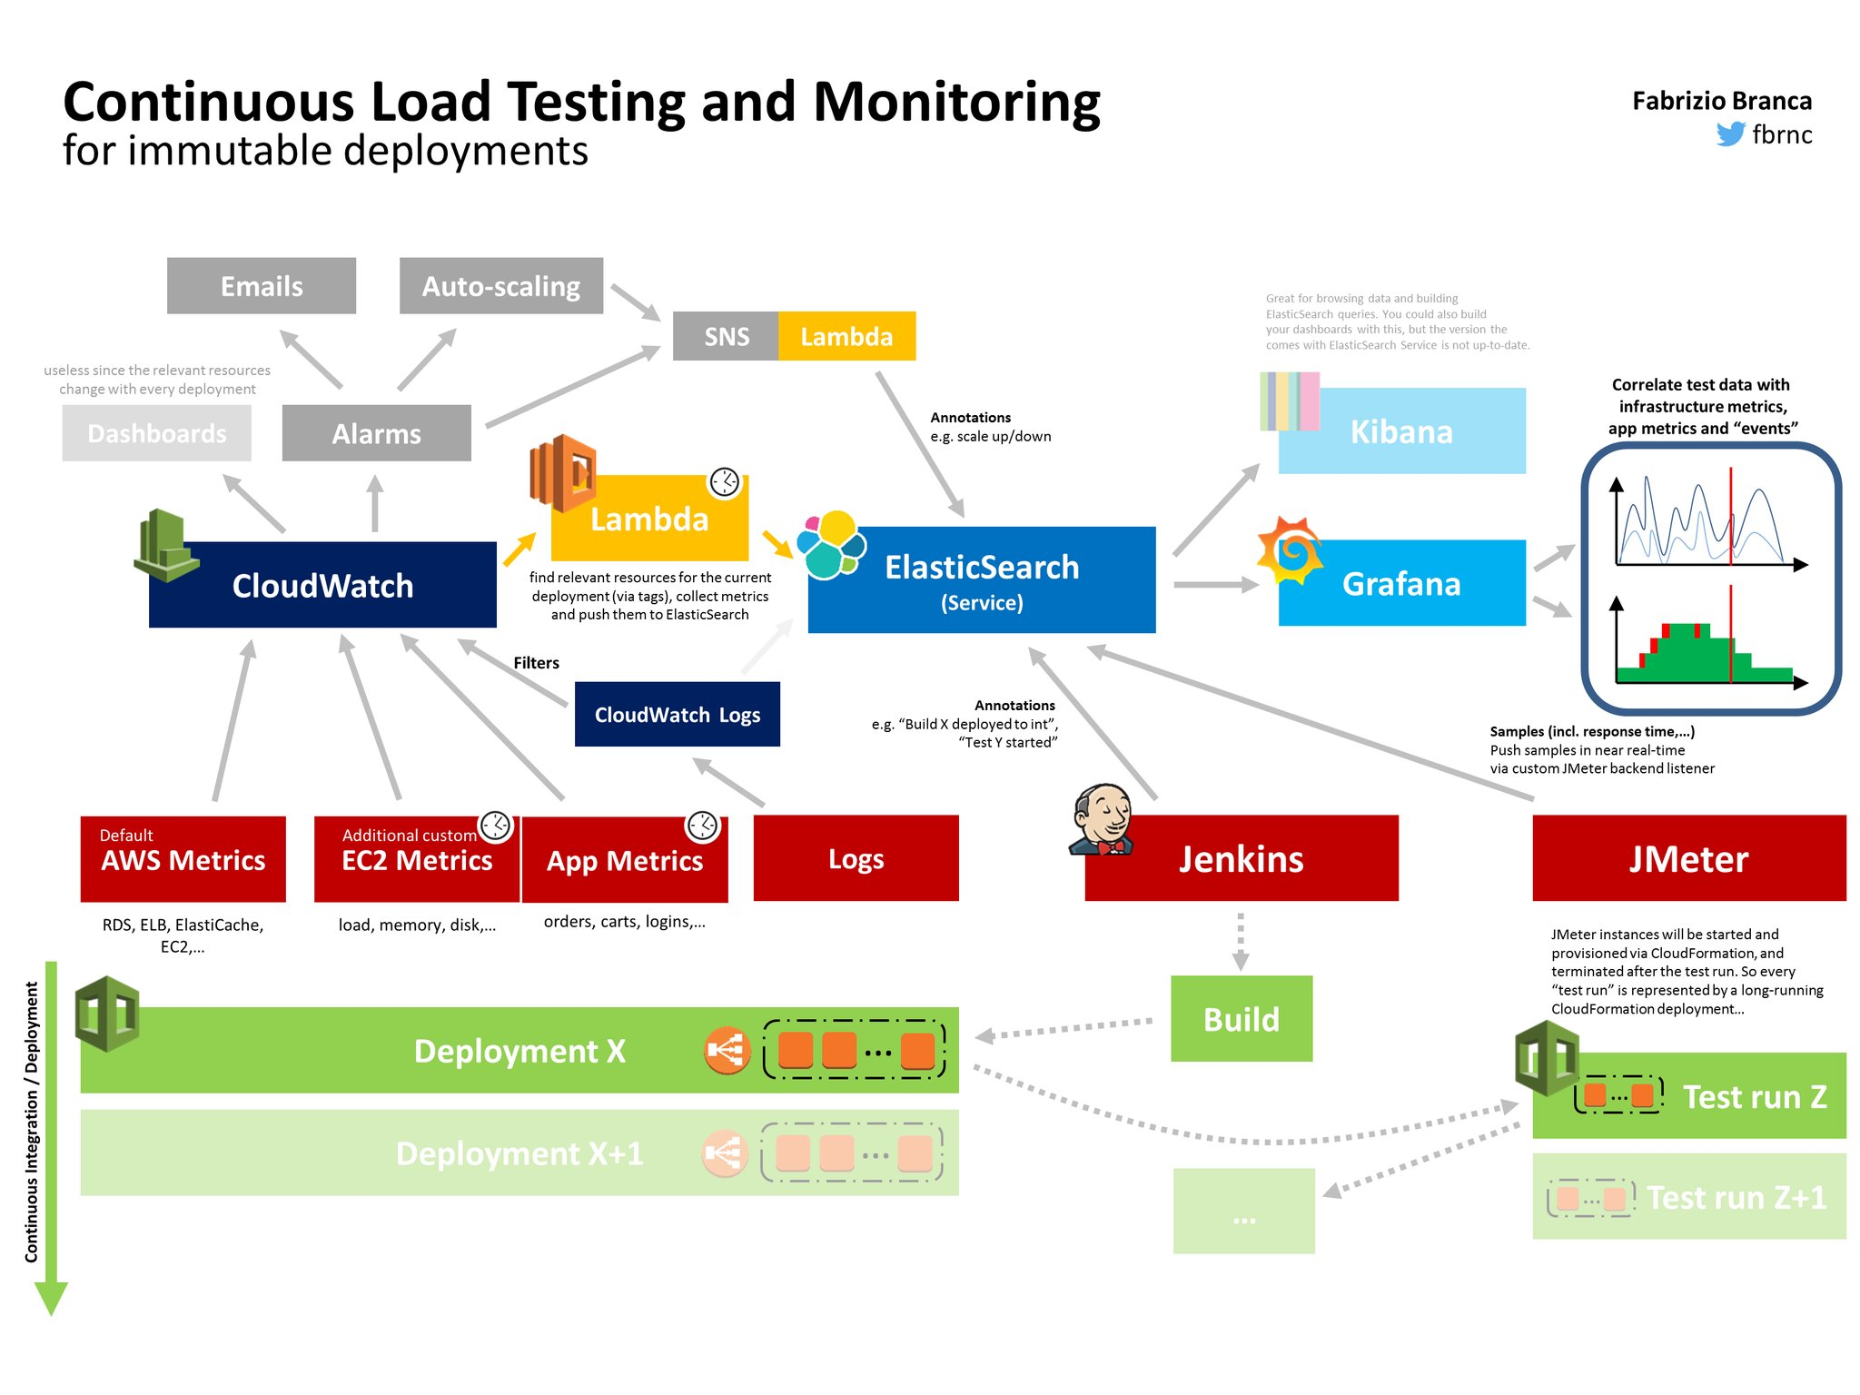
http://fbrnc.net/blog/2016/03/continuous-load-testing

Slide 43
Kibana & Other Visualizers

Slide 44
Kibana Overview
Kibana Interface has 4 Main sections:
Discover
Visualize
Dashboard
Settings
Some sections have the following options:
Time Filter: Uses relative or absolute time ranges
Search Bar: Use this to search fields, entire messages. Its very powerful
Additional save/load tools based on search or visualization.
Notes:
Typical Workflow: Create searches, make visualizations on them and add them to dashboards.

Slide 45
Kibana Search Syntax
Search provides an easy way to select groups of messages.
Syntax allows for booleans, wildcards, field filtering, ranges, parentheses and of course quotes
https://www.elastic.co/guide/en/kibana/3.0/queries.html
This just exposes Lucene Query Parser Syntax
Example:
type:“nginx-access” AND agent:“chrome”

Slide 46

Elasticsearch
Query Parser Syntax
SOLR and Elasticsearch both use this
Terms are the basic units, single terms and phrase.
Queries are broken down into terms and phrases, these can be combined with Boolean operators.
Supports fielded data
Grouping of terms or fields
Wildcard searches using the ? Or * globs.
Supports advanced searches
Fuzzy Searches
Proximity Searches
Range Searches
Term Boosting
https://lucene.apache.org/core/2_9_4/queryparsersyntax.html
Notes:
This is the key to figuring out the underlying search methods
Fuzzy: edit distance (Levenshtein Distance)
Proximity: within this many words from another word.
Range: dates, and alphabetical etc
Boosting: used to make a term more relavent

Slide 47
Kibana Discover
Notes:
Build searches to use in your visualizations and dashboards
Learn more about the data structure quickly
Dig into fields that you have ingested using logstash

Slide 48
Kibana Visualize
These are widgets that can be used on the dashboards
Based on the fieldsets in your index
Complex subject, details are outside of the scope of this presentation.
https://www.elastic.co/guide/en/kibana/current/visualize.html

Slide 49
Kibana Dashboard
Built from visualizations and searches
Can be filtered with time or search bar
Easy to use, adequate tools to create nice dashboards
Requires a good visualizations, start there first.

Slide 50

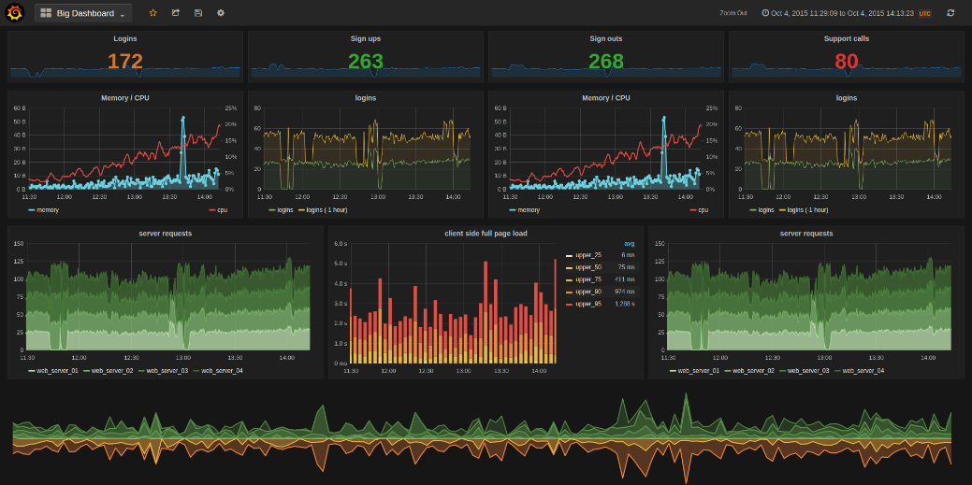
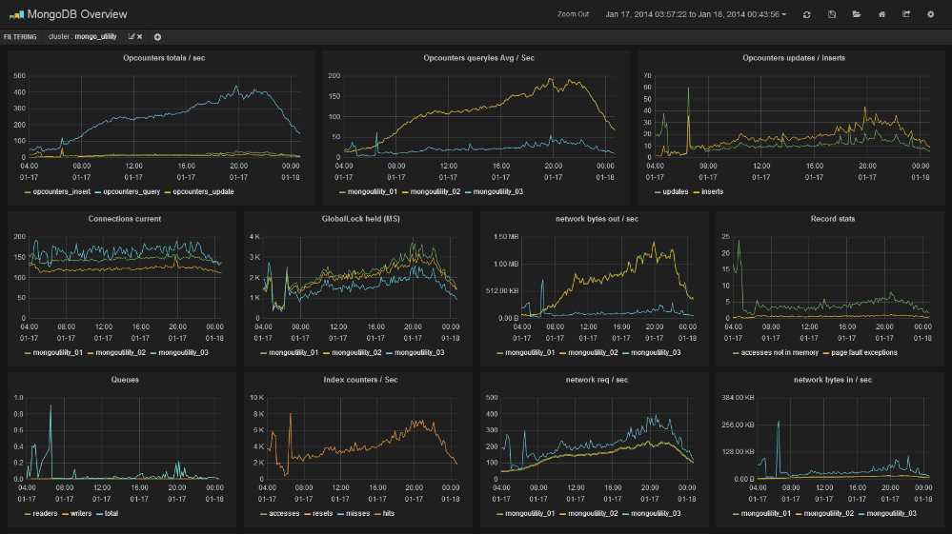
Grafana
Immensely Rich Graphing with lots more options compared to Kibana
Mixed style graphs with easy templating, reusable and fast
Built in authentication, allows for users, roles and organizations and LDAP support
Annotations and Snapshot Capabilities.
Kibana has better Discovery

Slide 51
Recap
Easy to setup ELK initially
Scaling presents some challenges, solutions exist and are well documented
Using ELK in production requires several additional components.
Kabana and other visualizations are easy to use but are a deep rabbit hole
Setup ELK and start playing today

Slide 52
Questions and Answers
Notes:
We will go over a few of the pain points, and interesting parts of trying to build ELK out to production scale.

Slide 53

Thanks / QA
Thanks to :
My Family
Robofirm Midwest PHP
The Magento Community
Fabrizo Branca
Tegan Snyder
Logz.io
Digital Ocean
Last but not least: YOU, for attending.
ELK: Ruminating On Logs
Rate this talk:
https://joind.in/talk/6a7c8
Mathew Beane <mbeane@robofirm.com>
Twitter: @aepod
Blog: http://aepod.com/

Slide 54
Attribution
Adobe Stock Photos:
Elk Battle
Complex Pipes
Old Logjam
ELK simple flowchart http://www.sixtree.com.au/articles/2014/intro-to-elk-and-capturing-application-logs/
Drawing in Logs http://images.delcampe.com/img_large/auction/000/087/301/317_001.jpg
Forest Fire http://www.foresthistory.org/ASPNET/Policy/Fire/Suppression/FHS5536_th.jpg
Log Train http://explorepahistory.com/kora/files/1/2/1-2-1323-25-ExplorePAHistory-a0k9s1-a_349.jpg
Docker Filebeat Fish https://github.com/bargenson/docker-filebeat
ELK Wrestling http://www.slideshare.net/tegud/elk-wrestling-leeds-devops
Drawing in Logs http://images.delcampe.com/img_large/auction/000/087/301/317_001.jpg
Log Flume Mill http://historical.fresnobeehive.com/wp-content/uploads/2012/02/JRW-SHAVER-HISTORY-MILL-STACKS.jpg
Log Shipping Pie Graph https://sematext.files.wordpress.com/2014/10/log-shipper-popularity-st.png
Logging Big Load https://michpics.files.wordpress.com/2010/07/logging-a-big-load.jpg

